Slide 1
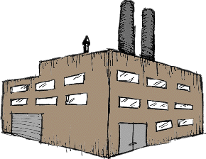
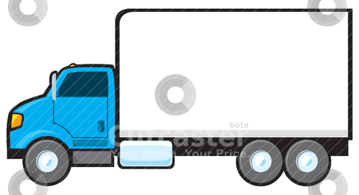
Endoplasmic reticulum is what make the proteins so its like a factory.
Hole 1
Golgi apparatuses transports proteins which is why its like a shipping truck.

Slide 2
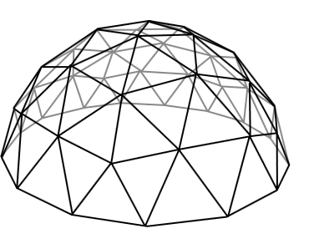
The cell membrane protects the whole cell and only lets certain things in just like a dome
Hole 2
Nuclear envelope protects the nucleus and that is why its like a house because a house protects people.

